Slide 1
Test Review & Reteach
[ 3.00 ] [ Today’s Date ] [ Instructor Name ]

Slide 2
Test Review:
Do you have any questions about the test?

Slide 3
1. What is a variable?
A syntactic structure that controls other statements.
The part of a Java program where we can use the variable.
A memory location with a name and a type that stores a value.
Combining several Strings into a single String, or combining a String with other data to into a new, longer String.
The order in which Java evaluates the operations in an expression.

Slide 4
2. What is operate precedence?
A syntactic structure that controls other statements.
The part of a Java program where we can use the variable.
A memory location with a name and a type that stores a value.
Combining several Strings into a single String, or combining a String with other data to into a new, longer String.
The order in which Java evaluates the operations in an expression.

Slide 5
3. What is the scope of a variable?
A syntactic structure that controls other statements.
The part of a Java program where we can use the variable.
A memory location with a name and a type that stores a value.
Combining several Strings into a single String, or combining a String with other data to into a new, longer String.
The order in which Java evaluates the operations in an expression.

Slide 6
4. What value does the following expression evaluate to?
( 5 + 7 ) % 8
4
2
1.5
1
0

Slide 7
5. Which of the following correctly assigns a value to the variable x?
(A) x int = 5;
(B) int x;
(C) x = 5;
(D) int x
(E) x = 5

Slide 8
6. Which of the following correctly declares a variable x of type int?
x int = 5;
(B) int x;
(C) x = 5;
(D) int x
(E) x = 5

Slide 9
7. Consider the following code segment:
int x = 1;
x++;
x++;
x *= 3;
x++;
1
(B) 3
(C) 9
(D) 10
(E) 11
What is the value of x after this code segment has been executed?

Slide 10
8. Consider the following code segment:
int x = 1;
int y = 8;
int z = x + y;
x = z / 4;
y = x + 1;
z += y;
(A) 13
(B) 12.25
(C) 1
(D) 8
(E) 12
What is the value of z after this code segment is executed?

Slide 11
9. What value does the following expression evaluate to?
( 1 + 2.0 + 3 ) / 4
1
(B) 1.5
(C) 2
(D) "12.034"
(E) Nothing, because Java expressions cannot mix int and double types.

Slide 12
10. What value does the following expression evaluate to?
1 + 2 + 3 + “4” + 5 + 6
21
(B) 123456
(C) “6456”
(D) "123456"
(E) Nothing, because Java expressions cannot mix int and String types.

Slide 13
11. Consider the following code segment:
for (int i = 2; i <= 8; i += 2) {
System.out.print(i + ", ");
}
System.out.println("Whom do we appreciate?");
What is output when this code segment is executed?
Hello, world.
1, 2, 3, 4, Whom do we appreciate?
4, 3, 2, 1, Whom do we appreciate?
2, 4, 6, 8, Whom do we appreciate?
8, 6, 4, 2, Whom do we appreciate?

Slide 14
12. Consider the following code segment:
int x = 1;
double y = x;
y = y / 2;
int z = (int)(y + 1.6);
What is the value of z after this code segment has executed?
0
1
2
3
4

Slide 15
13. Consider the following code segment:
for (int i = 1; i <= 3; i++)
System.out.println("Hey");
System.out.println("ya!");
What is output when this code segment is executed? Hint: curly braces { } are missing.

Slide 16
14. Consider the following complete program:
public class MyStars {
public static void printStar() {
System.out.println(" * ");
}
public static void loopStars() {
for (int i = 0; i < 2; i++) {
for (int j = 1; j <= i; j++) {
printStar();
}
}
}
public static void main(String[] args) {
loopStars();
}
}
How many stars * are printed to the console when this program is executed?
None
(B) 1
(C) 2
(D) 6
(E) 10

Slide 17
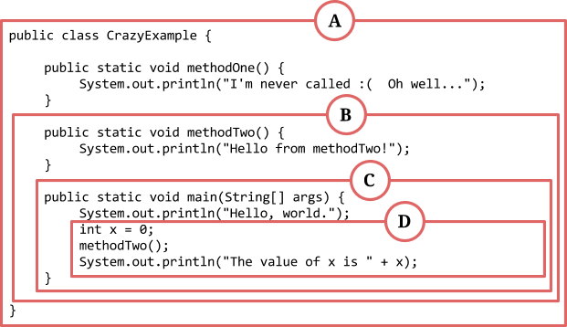
15. Consider the following code segment:
What is the scope for the variable x?

Slide 18
16. Consider the following complete program:
public class PrintSquaresAndCubes {
public static void main(String[] args) {
for (int i = 1; i <= 10; i++) {
System.out.println( i + " squared is " + ( i * i ));
}
for (int i = 1; i <= 10; i++) {
System.out.println( i + " cubed is " + ( i * i * i ));
}
}
}
Suppose we add the following CLASS_CONSTANT to the program:
public static final int MAX_VALUE = 10;
What is the most appropriate use of MAX_VALUE?

Slide 19
To replace the value 10 in the for loop, so we can change the output
of the program more easily by adjusting MAX_VALUE.
(B) To replace method header public static void main(String[] args),
because the program will become shorter.
(C) To replace the expression (i * i * i), which is too complicated for a simple program.
(D) To replace the class header public class PrintSquaresAndCubes,
which has too many capital letters in it.
(E) Hello, world.

Slide 20
Homework
Read HW 3.1 up to “Limitations on Parameters”
Correct any incorrect test answers by re-answering on a separate sheet of paper:
To get back credit, you must justify your new answers.
Staple new answer sheet to the old test and return it tomorrow.

Slide 21
Parameters
[ 3.01 ] [ Today’s Date ] [ Instructor Name ]

Slide 22

Notes:
Explain that problems happen when you don’t stay flexible with your programming. This image is an illustration of what can happen to your program if it isn’t made adaptable.

Slide 23
Old Program:
writeSpaces();
public void writeSpaces() {
for(int i = 0; i < 10; i++) {
System.out.print(“ “);
}
}
Notes:
How would we write 20 spaces? How about 25? It’s difficult or impossible for our program to change to fit our needs.

Slide 24
Old Program:
int number = 10;
writeSpaces();
public void writeSpaces(){
for(int i = 0; i < number; i++){
System.out.print(“ “);
}
}
Notes:
Would this work? No. Get the class to explain why this doesn’t work (outside scope!).

Slide 25
New Program:
public void writeSpaces(int number){
for(int i = 0; i < number; i++){
System.out.print(“ “);
}
}
Notes:
Would this work? No. Get the class to explain why this doesn’t work (outside scope!).

Slide 26
Calling Parameters:
Correct:
Incorrect:
writeSpaces(10)
writeSpaces(24901)
writeSpaces(9/3-2)
int x = 20;
writeSpaces(x);
writeSpaces();
writeSpaces(“ten”);
int y = 20;
writeSpaces(y);

Slide 27
Actual vs Formal Parameters
Actual Parameters (argument):
writeSpaces(10)
Formal Parameters (parameter):
public void writeSpaces(int x){
Notes:
The argument’s value is assigned to the formal parameter! Make sure the students know the difference; only the formal parameter is used in the method.

Slide 28
Mini Lessons

Slide 29
Things to think about:
Who is going to speak when?
How are you going to illustrate the flow of control?
What do you need to have up on the board to illustrate your mini-lesson, and who is in charge of writing it out?
Where and how will you feature the output produces by your code segment?

Slide 30
Practice It:
methodHeaderSyntax
MysteryNums
Oops3-errors

Slide 31
Homework
Read HW 3.1 “Limitations of Parameters” and “Multiple Parameters”
Complete self-check questions 4 – 7.

Slide 32
Limitations of Parameters & Multiple Parameters
[ 3.02 ] [ Today’s Date ] [ Instructor Name ]

Slide 33
public class ParameterExample {
public static void main (String[] args) {
int x = 17;
doubleNumber (x);
System.out.println (“x = “ + x);
System.out.println ();
int number = 42;
doubleNumber (number);
System.out.println (“number = “ + number);
}
public static void doubleNumber (int number) {
System.out.println (“Initial value = “ + “ + number”);
number = number * 2;
System.out.println (“Final value = “ + “ + number”);
}
}

Slide 34
Using Multiple Parameters
public static <type> <name> (<type> <name>, <type> <name>, … <type> <name>) {
<statement>;
<statement>;
…
<statement>;
}
method name (expression, expression, expression);

Slide 35
public class ParameterArt {
public static void main(String[] args){
writeChars('=', 20);
System.out.println();
for (int i = 1; i <= 10; i++){
writeChars('>', i);
writeChars(' ', 20 - 2 * i);
writeChars('<', i);
System.out.println();
}
}
public static void writeChars (char ch, int number) {
for (int i = 1; i <= number; i++){
System.out.print(ch);
}
}
}
Notes:
Go over what each part of the code does. Go over what happens when you change portions of the code.

Slide 36
Worktime

Slide 37
Homework
Read HW 3.1 “Parameters versus Constants” and “Overloading Methods”
Jazz up art projects and programs.

Slide 38
Return Values
[ 3.03 ] [ Today’s Date ] [ Instructor Name ]

Slide 39

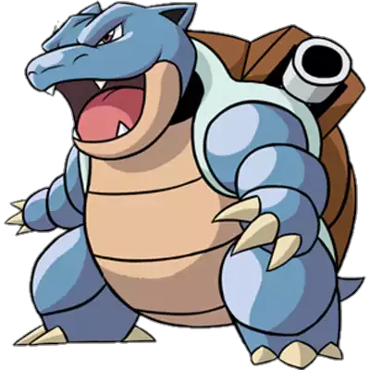
Pokémon

Slide 40
A program that returns a value:
Parameters can be manipulated, but don’t change.
int x = 10
change10to9(10); //THIS DOESN’T WORK!!
public static void change10to9(int x) {
x -= 1;
} //WHY?
So how do we get returned values?

Slide 41
The new method header:
public static double sum(double n){
}
Notes:
Feel free to live edit these slides to follow along with the lesson plan. Using a whiteboard may also be beneficial.

Slide 42
The new method header:
public static double sum(double n){
return (n + 1) * n / 2;
}
Notes:
Feel free to live edit these slides to follow along with the lesson plan. Using a whiteboard may also be beneficial.

Slide 43
Practice It
Work on the following self check questions:
parameterMysteryReturn
mathExpression2
min

Slide 44
Pokémon Challenge
A Pokémon's base stat values will most often have the greatest influence over their specific stats at any level. A level 100 Pokémon's stats in Attack, Defense, Speed, Special Attack, and Special Defense will be exactly 5 more than double its base stat values in each (leaving out individual values, effort values, and nature). The Hit Points (HP) stat will be 110 plus double the base stat value (except in the case of Shedinja, whose HP is always 1).
Notes:
Instruct the students to write the formulas down!

Slide 45
Pokémon Challenge
Write a program that returns a Pokémon’s stats for Attack and HP at level 100. You should use parameters and methods that return values for this program. You may choose to use the base stats for Blastoise OR Raichu given here:
Blastoise Raichu
HP: 79 HP: 60
Attack: 83 Attack: 90
Defense: 100 Defense: 55
Special Attack: 85 Special Attack: 90
Special Defense: 105 Special Defense: 80
Speed: 78 Speed: 110

Slide 46
Homework
Complete chapter 3 self-check question 17 and exercise 1.

Slide 47
Programming Project
[ 3.04 ] [ Today’s Date ] [ Instructor Name ]

Slide 48
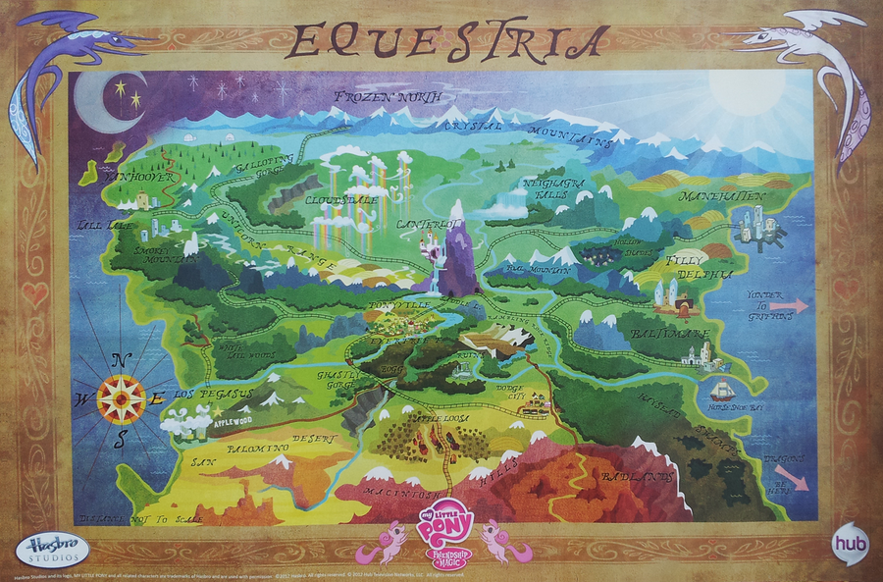
5
10
30
35
1
5
10
15
20

Slide 49
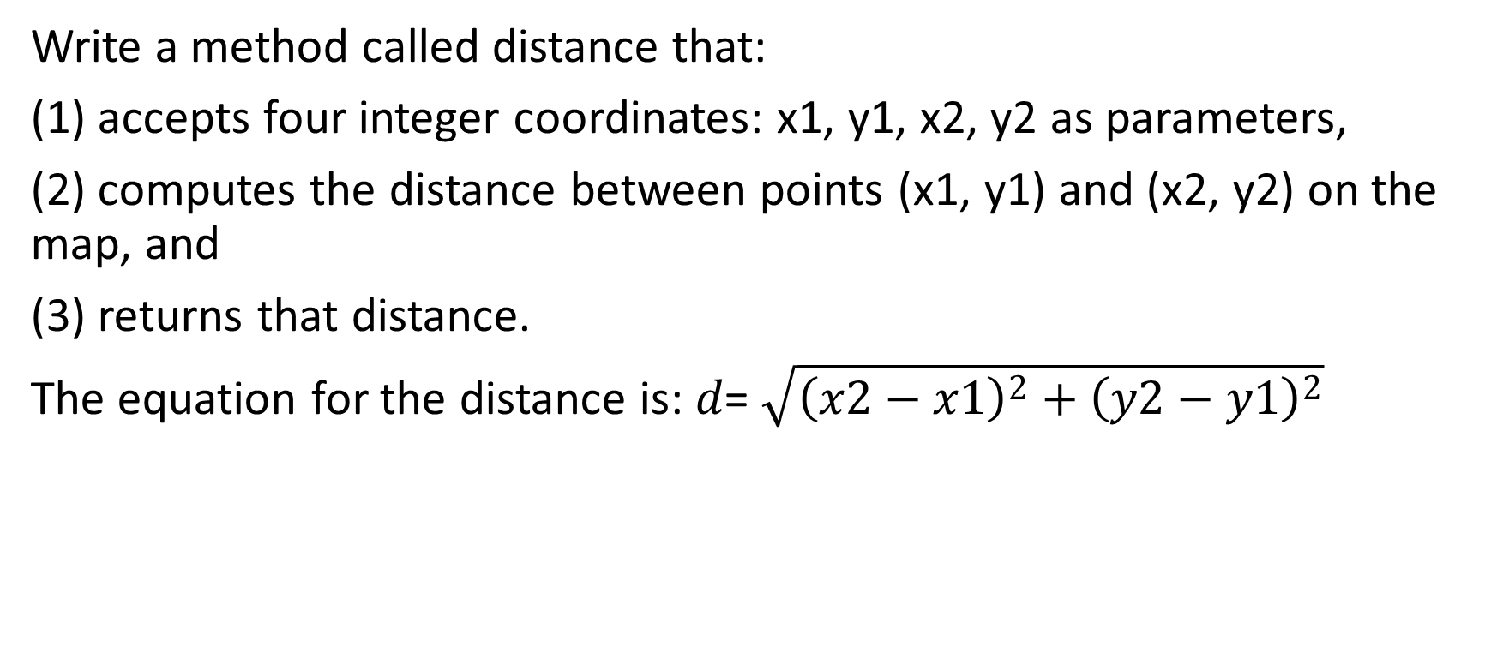
Exercise 1
Write a method called distance that:
(1) accepts four integer coordinates: x1, y1, x2, y2 as parameters,
(2) computes the distance between points (x1, y1) and (x2, y2) on the map, and
(3) returns that distance.
The equation for the distance is: 𝑑= $\sqrt{{\left(x2−x1\right)}^{2}+{\left(y2−y1\right)}^{2}}$
Notes:
Using the handout is recommended for readability.

Slide 50
Exercise 1 Cont.
Test out your program by writing a main method that calls the distance method for each of the following pairs of cities. Your main method should output the value returned by the distance method.
Distance from Baltimare to Manehattan =
Distance from Los Pegasus to Neighagra Falls =
Distance from the Badlands to Ponyville =
Notes:
Using the handout is recommended for readability.

Slide 51
Exercise 2
Princess Luna and Celestia are going on a tour of the kingdom to greet the other citizens of Equestria. Their tour takes them on a circular path (shown on map)
Write a method called roadTrip that
accepts as a parameter the diameter of the circular path, and
(2) returns the length of the trip
The equation for circumference is: C = dπ Java has a math constant called Math.PI
Notes:
Using the handout is recommended for readability.

Slide 52
Exercise 3
Write a program that helps Princess Luna plan a 3-stop tour of Equestria.
Your program should prompt the user (in this case Princess Luna) for three destinations in Equestria, as defined by their x and y coordinates on the map
You program should output the distance between the three destinations
You should use the distance methods you wrote for Exercise 1
Notes:
Using the handout is recommended for readability.

Slide 53
Exercise 4
Write a method called totalTrip that accepts parameters for 3 locations (each containing coordinates) and returns the total distance traveled by visiting all 3 locations and returning to the starting location. You should use the distance methods you wrote in Exercise 2 and you can choose any 3 locations in Equestria.
Extra credit: make this program compute 4 locations instead!
Notes:
Using the handout is recommended for readability.

Slide 54
Homework
Read HW 3.3. up to “Interactive Programs and Scanner Objects”
Complete Ch. 3 self-check questions 18 and 19.

Slide 55
Using Objects and String Processing
[ 3.05 ] [ Today’s Date ] [ Instructor Name ]

Slide 56
Worksheet

Slide 57
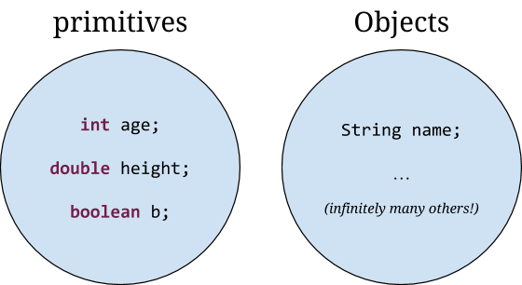
Primitives, Objects, and String Processing

Slide 58
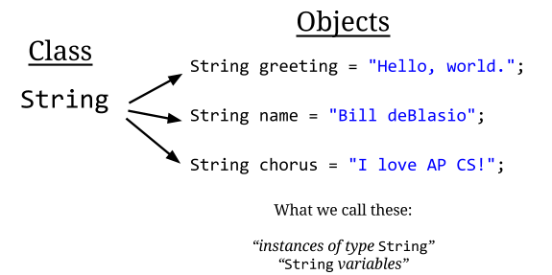
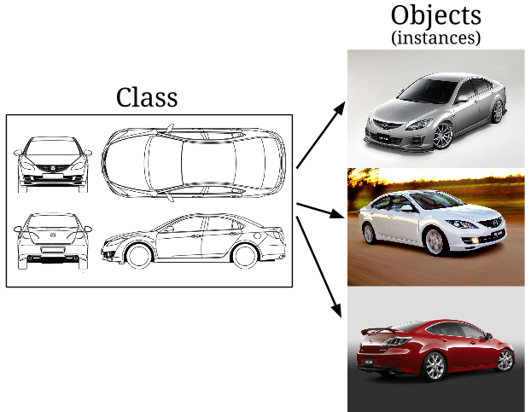

Slide 59
Object Variable Declaration
<variable name> = new <Class name> (<parameter1>, <parameter2>, …);
variable name – identifier that describe the content of variable
new – Java keyword stating to create on object of type <Class name>
<Class name> – name of class to create new object
(<parameter1>, <parameter2>,…) – parameter list dependent on the class constructor

Slide 60
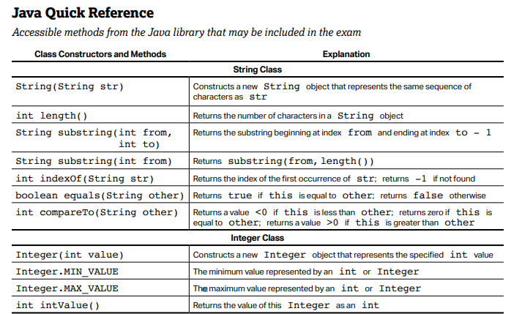
String Class
The String methods and constructors are part of the Java Quick Reference
Given to students during the AP exam
Including what they do and when they are used
https://apstudents.collegeboard.org/ap/pdf/ap-computer-science-a-java-quick-reference.pdf

Slide 61
String Constructor
The String class is special class in Java. There are two ways to create a String object.
String s = new String(“Hasta manana”);
String s = “Hasta manana”;

Slide 62
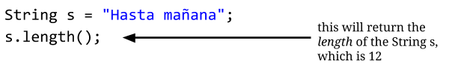
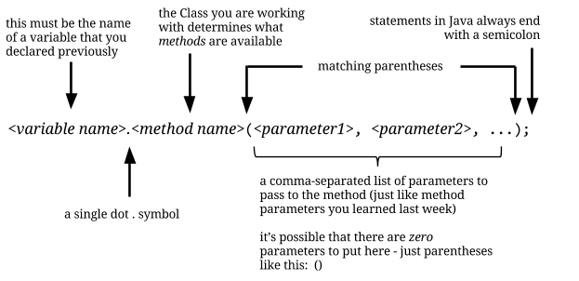
Object Methods: length()

Slide 63
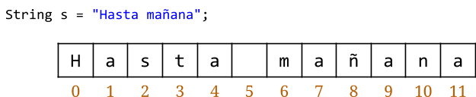
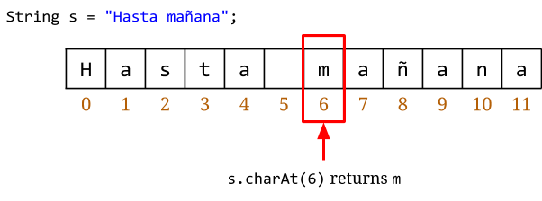
Single Character String Processing:
charAt()
substring(index, index + 1)
s.substring(6, 7) returns m

Slide 64
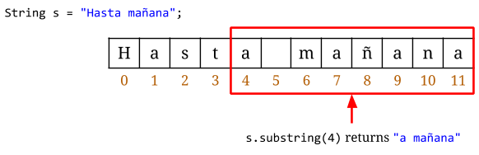
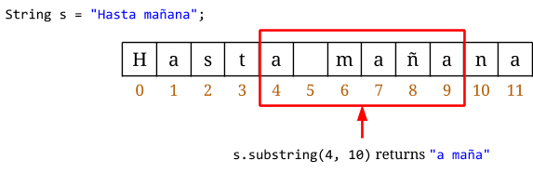
String Processing: substring()

Slide 65
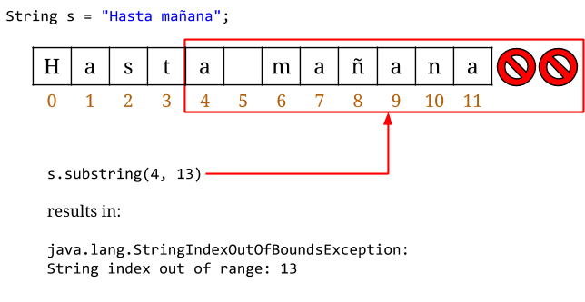
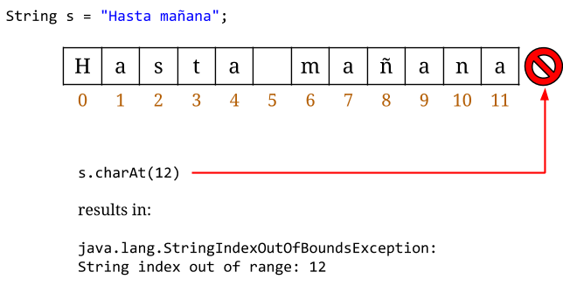
Errors: StringIndexOutOfBoundsException

Slide 66
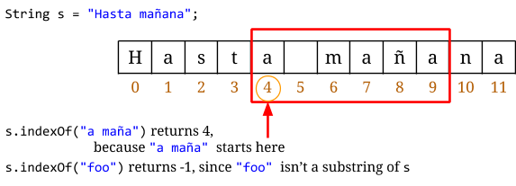
String Processing: indexOf()

Slide 67
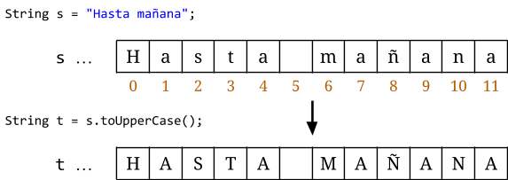
String Processing: toUpperCase()

Slide 68
String Comparison
boolean equals(String other)
Returns true if this is equal to other
Returns false otherwise
int compareTo(String other)
Returns a value <0 if this is lexicographically less than second string
Returns a value 0 if both strings are equal
Returns a value >0 if this is lexicographically greater than second string

Slide 69
Homework
Read HW 3.3. “Interactive Programming” and “Sample Interactive Program”
Complete Ch. 3 self-check questions 19 – 21.

Slide 70
Interactive Programs & Scanner Objects
[ 3.06 ] [ Today’s Date ] [ Instructor Name ]

Slide 71
Calculating a Pokémon's EV:
Pokémon have experience values which they gain when one Pokémon wins against another
These values are private (the user cannot see them) so in order to know what your EV is, you need to compute it yourself
Let’s write a program that helps us calculate EV!

Slide 72
Calculating a Pokémon's EV:
import java.util.*
Scanner userInput = new Scanner (System.in);
Notes:
Explain how import java.util.* imports the entire utilities library, give a small description of libraries and why we use them.
Explain all parts of the scanner: capitalization, new, system.in.

Slide 73
Calculating a Pokémon's EV:
System.out.print(“Hit points:”);
int hp = userInput.nextInt();
System.out.print(“Level: “);
int level = userInput.nextInt();

Slide 74
Calculating a Pokémon's EV:
System.out.print(“IV: ”);
int iv = userInput.nextInt();
System.out.print(“Base HP: “);
int base = userInput.nextInt();

Slide 75
Calculating a Pokémon's EV:
//The Pokémon's EV is calculated using the input variables!
int ev = (((hp – 10) * 100)/level – 2 * base – iv – 100) * 4;
System.out.println(“You have ” + ev + “ effort value points for your HP stat.”);

Slide 76
Practice It
Complete the following Practice self-check questions:
Self-Check 3.23: promptMultiplyBy2
Self-Check 3.24: SumNumbers
Self-Check 3.25: RobertPaulson
Complete the following Practice example questions:
Exercise 3.12: scientific
Exercise 3.14: cylinderSurfaceArea
Exercise 3.15: sphereVolume

Slide 77
Homework
Outline Chapter 3, except for reading HW 3.4

Slide 78
Pokémon Battle Programming Project
[ 3.07 ] [ Today’s Date ] [ Instructor Name ]

Slide 79


Slide 80
Pokémon Battle
Notes:
The programming project today has students programming a “starter” Pokémon battle sequence. This is a somewhat open-ended assignment, since students can submit a basic program that runs 1 or 2 interactions, or a complete battle sequence, depending on their level of understanding.
Student programs for this assignment will be a lobotomized version of a Pokémon battle since students have not yet learned conditional statements. This is a deliberate move: students can focus on building segments of code that accept basic user input, use the math class to generate random numbers to determine battle outcomes (or roll-of-the-dice or spin for the card-game and coin game versions), and return game text. Capitalize on student frustration by (or motivate students with the prospect of) hinting at a more interactive program after the next few lessons on Ch. 4 and Ch. 5.

Slide 81
Exercise 1:
Write a program called battleStart that introduces the battle, prompts the user to choose their first Pokémon, and outputs the pairing e.g.:
Another trainer is issuing a challenge!
Which Pokémon do you choose?
Zebstrika appeared.
It’s a Pokémon battle between Arcanine and Zebstrika.
Notes:
It’s wise to pass out worksheets so the students can work at their own paces.

Slide 82
Exercise 2:
Write a method called damage that prompts the user for their base stats and reports damage done to their Pokémon in battle.
Use this formula:
Damage = $\left(\frac{2∗Level+10}{250} ∗ \frac{Attack}{Defense }∗Base+2\right)∗Modifier$
Modifier = Same Type Attack Bonus (STAB) * Random
Hint: The Pokemon game always selects a random number between .85 and 1.0

Slide 83
Exercise 2, Output:
Zebstrika used Thunderbolt!
Trainer, what are your Arcanine’s stats?
Level:
Attack:
Defense:
Base:
STAB:
HP:
(Damage method returns value.)
Arcanine sustained 10 points damage. HP are now 70.

Slide 84
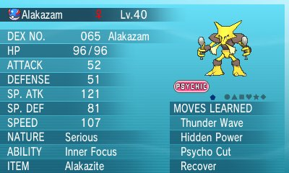
Exercise 3
Write a method called statsTable that accepts the user’s Pokemon stats and learned moves as parameters, and outputs text similar to this:

Slide 85
Sample output:
You’re not required to align everything, but if you do, use escape sequences!
Name Alakazam
Level 40
------------------------------
HP 96
ATTACK 52
DEFENSE 51
SP. ATK 121
SP. DEF 81
SPEED 107
-------------------------------
Moves Learned: Thunder Wave, Hidden Power, Psycho Cut, Recover

Slide 86
Homework
Summarize your class notes since the last exam.
If you are missing notes, get them from another student or supplement them from the textbook.

Slide 87
Finding and Fixing Errors
[ 3.08 ] [ Today’s Date ] [ Instructor Name ]

Slide 88
Homework Corrections

Slide 89
Homework
Read HW 4.1 up to “Nested if else Statements”
Complete Chapter 4 self-check problems 1 – 6.

Slide 90
Relational Operators and if/else
[ 3.09 ] [ Today’s Date ] [ Instructor Name ]

Slide 91
if statements
if (test) { test = boolean or expression
<statement>;
<statement>; control statements
}

Slide 92
if statements
if (test) {
execute this code
when test is true
}
execute this code always

Slide 93
if statements
if (2 < 3) {
System.out.println(“a”);
}
System.out.println(“b”);

Slide 94
if statements
if (3 < 2){
System.out.println(“a”);
}
System.out.println(“b”);

Slide 95
if statements
int i = 2;
int j = 3;
if (i < j) {
System.out.println(“a”);
}
System.out.println(“b”);

Slide 96
if – else statements
if (test) {
<statement>;
<statement>;
…
} else {
<statement>;
<statement>;
…
}
<statement>;…

Slide 97
if – else statements
if (2 < 3) {
System.out.println(“a”);
} else {
System.out.println(“b”);
}
System.out.println(“c”);

Slide 98
if – else statements
if (5 < 3){
System.out.println(“a”);
}else{
System.out.println(“b”);
}
System.out.println(“c”);

Slide 99
Grudgeball

Slide 100
Translate this statement into a logical test that can be used in an if else statement:
z is odd

Slide 101
Translate this statement into a logical test that can be used in an if else statement:
z is not greater than y’s square root

Slide 102
Translate this statement into a logical test that can be used in an if else statement:
y is positive

Slide 103
Translate this statement into a logical test that can be used in an if else statement:
Either x or y is even, the other is odd

Slide 104
Translate this statement into a logical test that can be used in an if else statement:
y is a multiple of z

Slide 105
Translate this statement into a logical test that can be used in an if else statement:
y is a non-negative one digit number

Slide 106
Given the variables: int x =4; int y = -3; int z = 4; What are the answers to the following (true/false)
x == 4

Slide 107
Given the variables: int x =4; int y = -3; int z = 4; What are the answers to the following (true/false)
x == y

Slide 108
Given the variables: int x =4; int y = -3; int z = 4; What are the answers to the following (true/false)
x == z

Slide 109
Given the variables: int x =4; int y = -3; int z = 4; What are the answers to the following (true/false)
x + y > 0

Slide 110
Given the variables: int x =4; int y = -3; int z = 4; What are the answers to the following (true/false)
y * y <= z

Slide 111
Given the variables: int x =4; int y = -3; int z = 4; What are the answers to the following (true/false)
x * (y + 2) > y – (y + z) * 2

Slide 112
Correct the statement header syntax:
if x = 10 then {

Slide 113
Correct the statement header syntax:
if [x = 10] {

Slide 114
Correct the statement header syntax:
if (x equals 42) {

Slide 115
Correct the statement header syntax:
if (x == y) {

Slide 116
Correct the statement header syntax:
if (x > 8) {

Slide 117
Correct the statement header syntax:
IF (x <= 7) {

Slide 118
public class Oops4 {
public static void main(String[] args) {
int a = 7,
b = 42;
minimum(a,b);
if {smaller = a} {
System.out.println(“a is the smallest!”);
}
}
//Returns the minimum of the parameters a and b.
public static void minimum (int a, int b){
if (a < b) {
int smaller = a;
} else (a = b) {
int smaller = b;
}
return int smaller;
}
}
Correct one of the (7) errors
in the following code.

Slide 119
Homework
Read HW 4.1 “Nested if/else” and “Object Equality”
Complete Chapter 4 self-check questions 7 – 9 and exercises #1 & 2

Slide 120
Nested if/else Statements
[ 3.10 ] [ Today’s Date ] [ Instructor Name ]
Notes:
Day is in mini lesson --- review Lesson Plan

Slide 121
Practice It:
ifElseMystery1
ifElseMystery2
season

Slide 122
Homework
Read HW 4.1 “Factoring if/else Statements” and “Testing Multiple Conditions”
Complete exercises #4 and 5

Slide 123
Reducing Redundancy
[ 3.11 ] [ Today’s Date ] [ Instructor Name ]

Slide 124
Classroom Competition

Slide 125
Factor out redundant code from the following example by moving it out of the if/else statement, preserving the same output.
if (x < 30) {
a = 2;
x++;
System.out.println(“Spongebob Squarepants! “ + x);
} else {
a = 2;
System.out.println(“Spongebob Squarepants! “ + x);
}

Slide 126
int sum = 1000;
Scanner console = new Scanner(System.in);
System.out.print(“Is your money multiplied 1 or 2 times? ”);
int times = console.nextInt();
if (times == 1) {
System.out.print(“And how much are you contributing? “);
int donation = console.nextInt();
sum = sum + donation;
count1++;
total = total + donation;
}
if (times == 2) {
System.out.print(“And how much are you contributing? “);
int donation = console.nextInt();
sum = sum + 2 * donation;
count2++;
total = total + donation;
}
Rewrite the poorly-structured code given here, so it avoids redundancy.
For the case of this competition, you can assume that the user always inputs 1 or 2.

Slide 127
Outline Chapter 4

Slide 128
Homework
Read HW 4.2
Finish outlining Chapter 4, excluding sections 4.3, 4.4, and 4.5

Slide 129
Cumulative Algorithms
[ 3.12 ] [ Today’s Date ] [ Instructor Name ]

Slide 130
Class Activity
Notes:
Numbers for example: 8 + 51 + 79 + 13 + 16 + 93 = 260

Slide 131
Pseudocode:
int sum = 0
for (all numbers to sum) {
obtain “next” with Scanner
sum += next
** remember import.java.util.* (why)

Slide 132
Writing the program:
Use a whiteboard or type it out up on the screen!
Notes:
Going over the example on the board is generally better for writing out problems like these.

Slide 133
Pseudocode
for (all numbers to compare){
obtain “next” with scanner
if (next > max) { or if(next < min){
max = next min = next

Slide 134
Writing the program:
Use a whiteboard or type it out up on the screen!
Notes:
Going over the example on the board is generally better for writing out problems like these.

Slide 135
Worksheet

Slide 136
Homework
Read HW 5.1 (skip “do/while loops”)
Complete Chapter 4 Programming Project 2

Slide 137
While Loops
[ 3.13 ] [ Today’s Date ] [ Instructor Name ]

Slide 138
Pseudocode for Pokemon Damage

Slide 139
Categories of loops
definite loops: Executes a known number of times.
e.g. for loops
Print “hello” 10 times.
Find all the prime numbers up to integer n.
Print each odd number between 5 and 127.
indefinite loops: One where the number of times it’s run is not known.
Prompts the user until they type a non-negative number.
Print random numbers until a prime number is printed.
Repeat until the user types “q” to quit.

Slide 140
The while loop:
while loop : Repeatedly executes its body as long as the test is true.
while (test) {
statements(s);
}
Example:
int num = 1;
while (num <= 200) {
System.out.print(num + “ ”);
num = num * 2;
}

Slide 141
What’s the difference?
while loop
for loop
int i = 0;
while (i < 10) {
System.out.println(i);
i++;
}
for (int i = 0; i < 10; i++) {
System.out.println(i);
}

Slide 142
Think-pair-share:
How many times does this loop execute?
What is the output?
Try rewrite this loop as a for loop.
int n = 91;
int factor = 2;
while (n % factor != 0) {
factor++;
}
System.out.println(“First factor is “ + factor);

Slide 143
Practice Problem
Work on the following practice problems:
Self-Check 5.1: whileLoops
Self-Check 5.2: forToWhile
Self-Check 5.3: whileLoopMystery1
Self-Check 5.4: whileLoopMystery2
If there’s extra time, work on “gcd”

Slide 144
Homework
Read HW 5.1 “Random Numbers”
Complete Chapter 5 self-check questions 1 – 4 an exercise 2

Slide 145
Random Numbers
[ 3.14 ] [ Today’s Date ] [ Instructor Name ]

Slide 146
When do we use randomization?
Create an enemy that spawns after some random amount of time, but between 7 and 23 seconds.
Pick a random item from a list of 100 words the user needs to guess in Hangman
Create a new username between 6 and 10 characters picking randomly what each character is, from lower/capital letters and numbers.
Make a ball bounce, but not precisely, by adding random angles to the bounce.

Slide 147
Let’s make some random numbers:
How do we make a random object?

Slide 148
Let’s make some random numbers:
How do we make a random object?
Random r = new Random();

Slide 149
Let’s make some random numbers:
Random r = new Random();
result = r.nextInt(6); //Gives a number between 0 and 5
result = r.nextInt(6) + 1; //between 1 and 6.
System.out.println(“You rolled a “ + result);

Slide 150

Think-Pair-Share
Write an expression that simulates a roll of a 20 – sided dice.
Write an expression that yields a random number between 0.0 and 1.0.

Slide 151
Table 5.2:
nextInt() = random integer between -2^21 and (2^31 -1)
nextInt(max) = random integer between 0 and (max – 1)
nextDouble() = random real number between 0.0 and 1.0
nextBoolean() = random logical value of true or false
Priming the loop.

Slide 152
Practice Problems
Work on the following practice problems:
Self-Check 5.5: randomRangeABCDE
Self-Check 5.6: randomInteger0to10
Self-Check 5.7: randomOddInteger50to99
If there’s extra time, work on randomX and randomLines.
If there’s even more extra time, work on threeHeads.

Slide 153
Homework
Read HW 5.2
Complete Chapter 5 programming project 1.

Slide 154
Fencepost & Sentinel Loops
[ 3.15 ] [ Today’s Date ] [ Instructor Name ]

Slide 155
Class activity:
Prepare a 5 minute lesson and a 2 – 5 minute class activity to teach a topic using this grading rubric:
3 pts. | 2 pts. | 1 pts. | 0 pts.
Presentation includes definitions and an example with proper syntax. | Presentation includes definitions or an example with proper syntax. | Presentation includes definitions or an example with proper syntax with one mistake. | Presentation includes definitions or an example with proper syntax with many mistakes.
Presentation includes a non-example as helpful contrast. | Presentation includes a non-example that is marginally helpful. | Presentation includes a non-example that does not add to comprehension. | Presentation includes a non-example that adds confusion, or presentation does not include a non-example.
Presentation includes a helpful tip that is clearly explained and concisely stated. | Presentation includes a helpful tip that is clearly explained or concisely stated. | Presentation includes a helpful tip that is not clearly explained and may include a small error. | Presentation does not include a helpful tip or hint.

Slide 156
Class activity:
Who is going to speak when?
How are you going to illustrate the flow of control?
What do you need to have up on the board to illustrate your mini-lesson and who is in charge of writing it out?
Where and how will you feature the output produced by your code segment?
What is your mini-activity going to look like?

Slide 157
Presentations

Slide 158
Homework
Read HW 5.3
Complete Chapter 5 exercises 6 and 8
Summarize all of your daily notes if not already done.

Slide 159
Boolean Logic
[ 3.16 ] [ Today’s Date ] [ Instructor Name ]

Slide 160
What are these things?
for (int i = 0; i < 4; i++) {
System.out.println(i)
}
int j = 0;
while (j * j < 20){
System.out.println(j);
j = j * 2 – 1;
}
Notes:
These slides are for review if your class is struggling with Booleans

Slide 161
boolean : the easiest type!
Only two values:
true
false
<expression> <relational operator> <expression>
3 * 3, x ==, != 3 * 1 * 3, y
Notes:
These slides are for review if your class is struggling with Booleans

Slide 162
Making Booleans!
Perform a test
Evaluates to a boolean value
Operator | Meaning | Example | Value
== | equals | 1 + 1 == 2
!= | does not equal | 3.2 != 2.5
< | less than | 10 < 5
> | greater than | 10 > 5
<= | less than or equal to | 126 <= 100
>= | greater than or equal to | 5.0 >= 5.0
Notes:
These slides are for review if your class is struggling with Booleans

Slide 163
Boolean Logic
Expanding on true and false: !, &&, and ||
AND (4 == 4) && (2 > 1) Evaluates to: true
OR (1 < 2) || (2 < 1) Evaluates to: true
NOT !(2 < 1) Evaluates to: true

Slide 164
Boolean Logic
if(q == 1 || 2 || 4){ //This doesn’t work
statement; //you need to use full
statement; //boolean expression!
}
if(q == 1 || q == 2 || q == 4){
statement;
statement;
}

Slide 165
Working with De Morgan’s Laws
p | q | p || q | !(p || q) | !p | !q | !p && !q
F | F
F | T
T | F
T | T

Slide 166
Programming Activity
Notes:
On worksheet 3.16

Slide 167
Homework
Outline Chapter 5 (up to and including HW 5.3)

Slide 168
Finding and Fixing Errors
[ 3.17 ] [ Today’s Date ] [ Instructor Name ]
Notes:
This unit is mostly done either on practice it or the board. Feel free to edit this slide deck as you see fit!

Slide 169
Today’s plan:
Error check and resubmit all chapter 3, 4, and 5 assignments.
Study for the test by:
Reviewing all of the blue, self-check pages at the end of Chapter 3, 4, and 5.
Re-reading sections as needed to complete the self-check problems.
Submit 5 questions for review in class tomorrow.

Slide 170
Homework Regrade/Resubmit
You all have the opportunity to get full credit on your homework grades by correcting them now, in class.
Use your error checking algorithm, and if you need help just ask!
Make sure to check for issues with scope!

Slide 171
If you finish early:
Some useful review includes working on :
Programming Project 1 Chapter 5

Slide 172
Homework
Begin reviewing chapters 3, 4 and 5 for the Unit Test.
Submit 5 questions you have for review tomorrow.

Slide 173
Review
[ 3.11 ] [ Today’s Date ] [ Instructor Name ]

Slide 174
What’s on the test?

Slide 175
Review Questions
Use submitted review questions to review for the test
Assemble the questions into categories to go over
Answer individual questions, or make slides for topics you think students need to go over

Slide 176
Review Topics
Make a list of review topics that you feel you need to go over for the test tomorrow
For each topic, follow up by reviewing the textbook, self-check problems, and the appropriate Practice problems

Slide 177
Good Luck!

